Slide 1

IMDB Final Project

Slide 2
THE IMDB
The IMDB is acronym for Internet Movie Database. It is popular as a reliable resource of information about
Movies
Tv shows -Seasons -Episodes
Actors
Additionally, Users are welcomed to add
- Content
- Ratings
- Reviews
- Conduct Poll and Discuss on forum
- Check showtiming in theatre and buy ticket(3rd Party)

Slide 3
In our Project –
Replicated a mini-version of IMDB
Executed it on MSSQL, Oracle and HIVE In addition, we have
In-House Ticketing System
Artists like Actor, Director via Cast

Slide 4
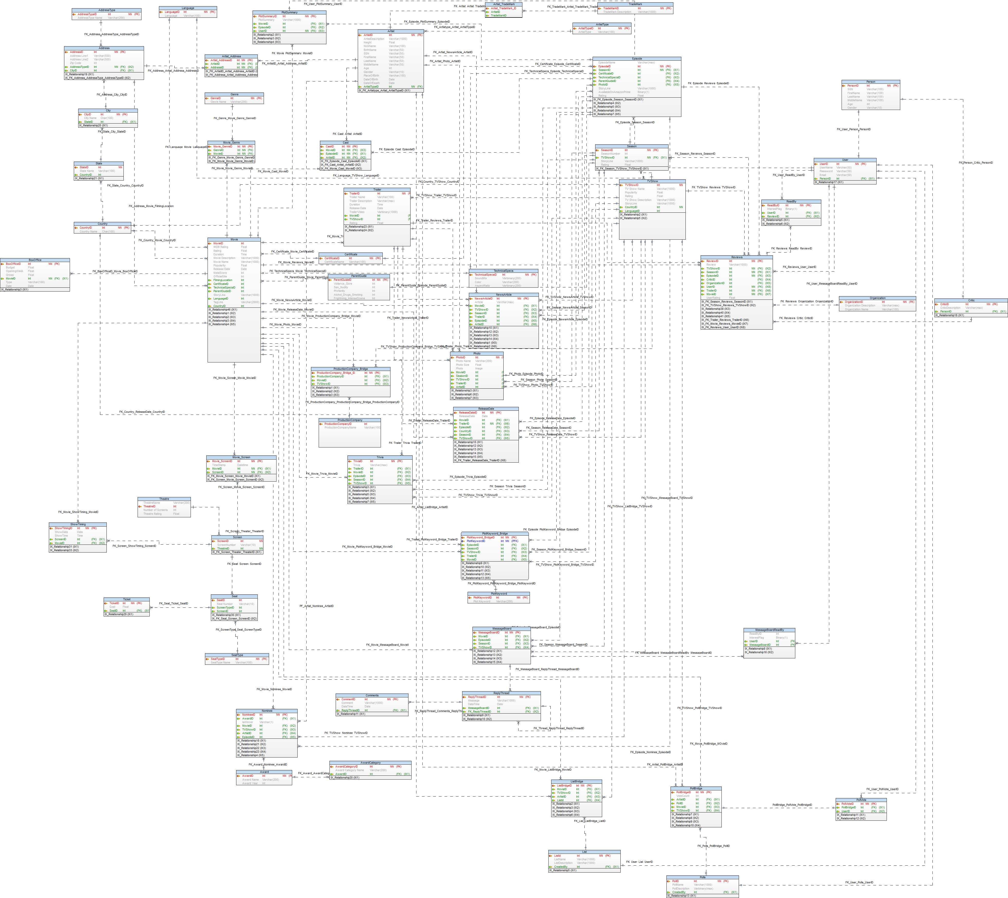
Toad
ER Model
Queries
Procedure
Trigger

